Slide 1
LoboWeb for Faculty
Class Rosters, Registration Overrides,
and other functions

Slide 2
Topics
Accessing LoboWeb
LoboWeb Basics
View Student Info
Class Lists: Dropping and Emailing Students
Registration Deadlines
Override Registration Errors
Updating Course Information

Slide 3
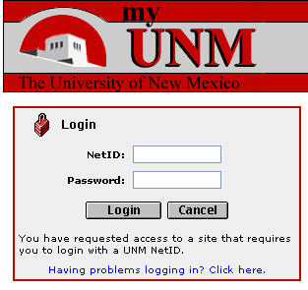
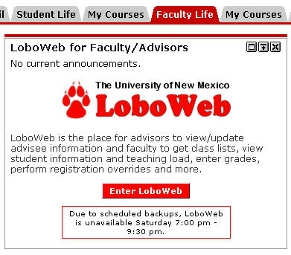
Accessing LoboWeb
my.unm.edu
Login using your NetID and Password
Click on the Faculty or Employee Life tab
Click on LoboWeb

Slide 4
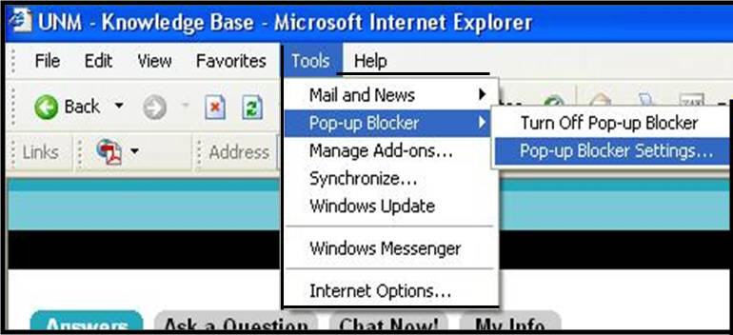
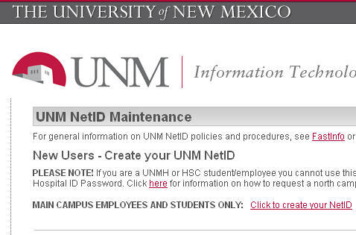
Problems Accessing LoboWeb?
my.unm.edu allowed by pop-up blockers?
NetID/Password problem? Go to NetID.unm.edu
FastInfo 1105
FastInfo 28

Slide 5
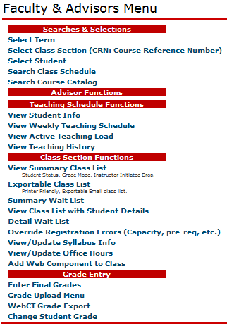
LoboWeb Basics
Choose your Term, Class Section, and/or Student before doing anything.
For students not in your classes, their UNM ID # is required for selection.
Check rosters (before refund and grade deadlines), drop students, export and print rosters, override registration errors for students, and update your course information.
Enter and Change grades.

Slide 6
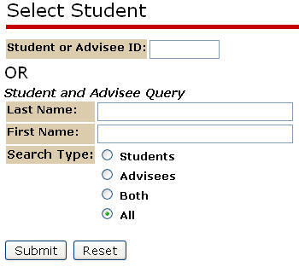
Select Student
If the student is not enrolled in one of your courses, they will need to provide their UNM ID#.
If the student is enrolled in one of your courses, you may search by name.
Use “%” and “_” for multi- and single-character wildcards.
FastInfo 2937

Slide 7
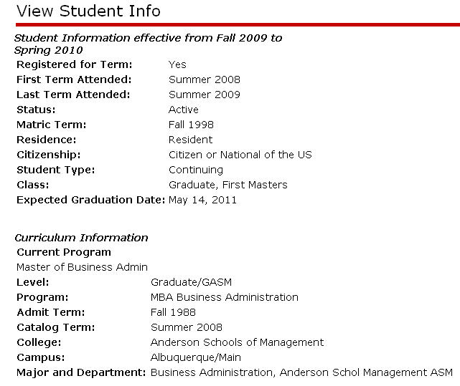
View Student Info
Information about students enrolled in your courses.
Be aware of Confidential indicators.
Links to email and telephone information are at the bottom of the page.

Slide 8
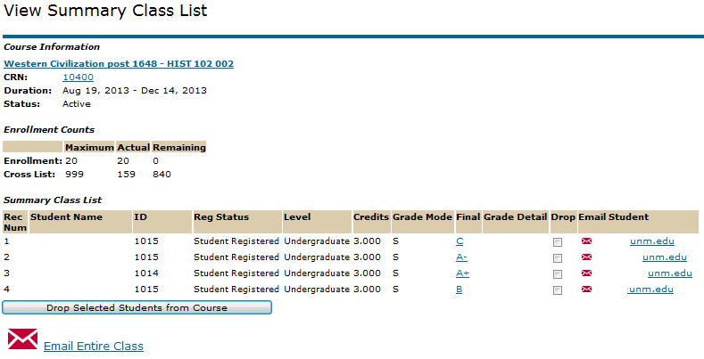
View Summary Class List
FastInfo 2931
1) Click the “Drop” box for each student you wish to drop.
2) Click “Drop Selected Students from Course” to process.
A results page will then display.
Email individual students above,
or the entire class to the left.

Slide 9
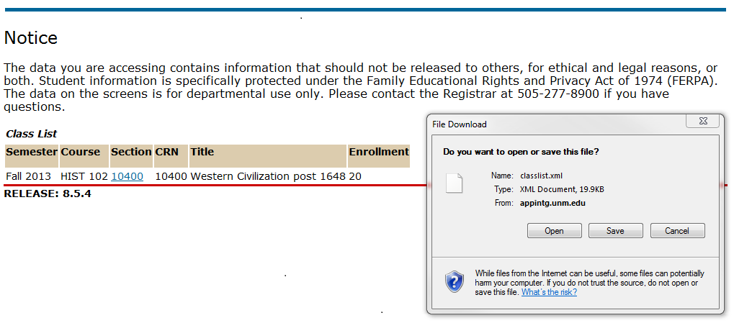
Exportable Class List
FastInfo 3194
This process generates an XML file to open or save.
Most spreadsheet software can read these files but a default program needs to be selected before they will open automatically.

Slide 10
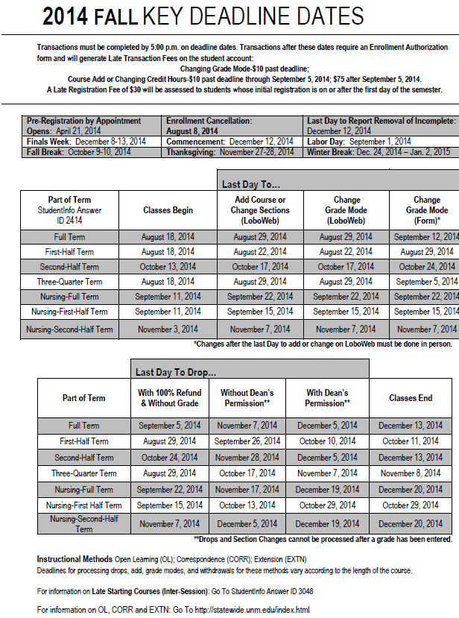
Registration Deadlines
Deadlines vary by part-of-term (full, 1st/2nd half, etc.) but for 16 week terms are:
Last day to add: 2nd Friday
Refund: 3rd Friday
Drop w/o grade: 3rd Friday
Drop w/o permission: 12th Friday
More deadline details can be found at registrar.unm.edu – Deadline Dates
Check rosters before the refund/grade deadlines.
FastInfo 3173

Slide 11
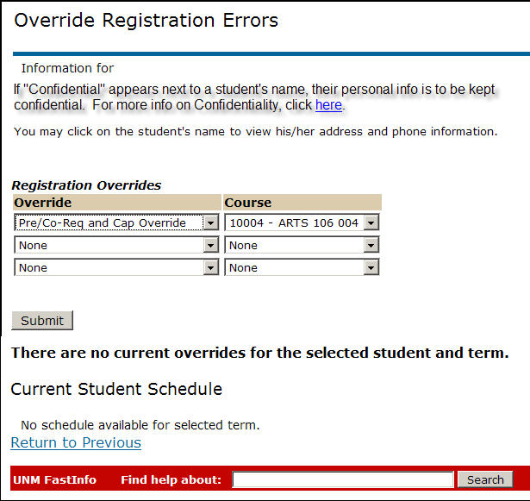
Override Registration Errors
Allow students to bypass restrictions
All but Duplicate and Level may be overridden here.
Choose Override and Course then Submit. The student may then register.
Student’s UNM ID# is required.
Check with your Department for guidelines on using this function (ability vs. authority).
FastInfo 2349

Slide 12
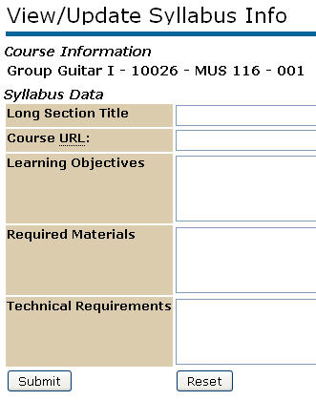
Updating Course Information
Add section website and other details.
FastInfo 2883
& 3337
Publish office hours for one, some, or all sections assigned.
Add Learn components to assigned sections.

Slide 13
FastInfo.unm.edu
Answers to your frequently asked questions …
2933: What is my Privacy/Confidentiality Indicator?
3173: What are the Refund, Grade, and other Registration Deadline Dates?
2380: How do UNM Faculty and Advisors use LoboWeb?
2931: How do I send email to my class list via LoboWeb?
2903: Can I initiate dropping a student from my class?
2349: How do faculty members override registration errors?
2046, 2063, 5119: Enrollment Authorization Forms
2373: What is UNM Learn?

Slide 14
Learning Central
Employee Life – Banner Training
https://learningcentral.health.unm.edu
Recommended courses:
FINPRV100 or FINPRV101 Securing Private Data (Web Course or Instructor-Led)
BANS-0004 Faculty Lobo Web (Online)
BANS-0015 Final Grade Submission (Online)
Faculty/Advisor Update
You will receive email updates throughout the term about upcoming deadlines and process information.

Slide 15
Office of the Registrar
In Person
One-Stop
Mesa Vista Hall – North
Or
Student Success and Support Center
MSC11 6325
By Phone
505.277.8900
Or
Online
Registrar.unm.edu
We are here to help with any questions you may have!

